Slide 1
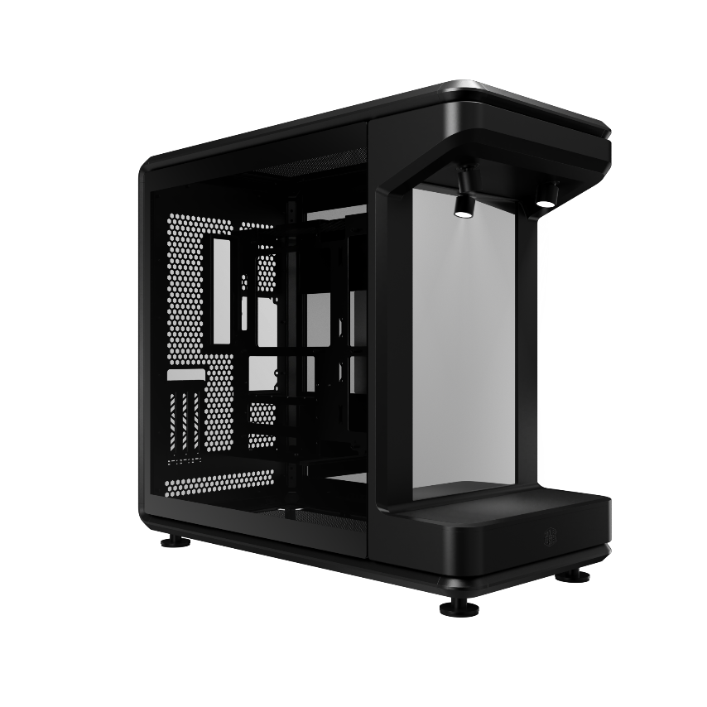
MASTERFRAME 360 STAGE MIRROR
MASTERFRAME 360 STAGE MIRROR
Featuring a distinctive front-facing mirrored platform, STAGE MIRROR is designed for creators, collectors, and enthusiasts who value both performance and personal style.
The mirrored surface enhances visual depth while reflecting your collectibles from multiple angles—creating a 360-degree showcase experience that highlights every detail.
Whether you’re building a high-end rig, displaying treasured items, or crafting a setup that tells your story, STAGE MIRROR is your ultimate stage for self-expression.
FEATURES
Open Display Stage for Personal Expression
The STAGE MIRROR is more than just a PC case—it’s a stage for personal expression.
Its open-frame design removes traditional enclosure constraints, allowing you to freely position figures, collectibles, and creative accessories without visual or spatial limits.
Combined with the signature front-facing mirror, it creates a 360-degree display effect—reflecting every angle in vivid detail. This unique design transforms your build into a personal gallery, where story and style take center stage.
Massive Cooling Compatibility
To ensure exceptional thermal performance, the case supports fan sizes ranging from 120 mm to 200 mm, with space for up to twelve 120 mm fans—six on the top and six on the bottom. It also supports radiators up to 360 mm, meeting the cooling demands of high-end custom liquid cooling setups.
Compatible with Standard and BTF Motherboards
Compatible with Mini-ITX, Micro-ATX, and ATX motherboards, including BTF (back-connect) layouts within the ATX form factor.
Features 110 mm of cable routing clearance for a clean and clutter-free showcase.
PCIe 5.0 Riser Cable Included
Includes a premium PCIe 5.0 riser cable that enables vertical GPU mounting providing both next-gen performance and an elevated presentation right out of the box.
Wide Component Compatibility
Accommodates up to 430 mm GPUs and 210 mm PSUs built to handle flagship components without compromise.
Next-Gen Connectivity at Your Fingertips
Features USB 4.0 Gen 2x2 Type-C (up to 20G) and 2x USB 3.2 Gen 1 Type-A ports (up to 5G), providing ultra-fast data transfer and future-ready accessibility.

Slide 2
MASTERFRAME 360 STAGE MIRROR
PRODUCT SPECIFICATIONS
Product Information | Product Name | MASTERFRAME 360 STAGE MIRROR
 | Series | MASTERFRAME Series
 | Color | Black
 | Model Number | MF360-KHNN-S01
Materials | Exterior | SGCC
 | Side Panel (Left / Right) | TG / TG
Dimension (L x W x H) | Incl. Protrusions | 549 x 291 x 581 mm
 | Excl. Protrusions | 511 x 291 x 581 mm
 | Volume (w/o panel, protrusions and feet) | 86 L
 | Volume (with panel, protrusions and feet) | 93 L
Hardware support | Motherboard Support | Mini-ITX, Micro-ATX, ATX, BTF (ATX)
 | Power Supply Support | ATX
 | PCI Expansion Slots | 3.5
Drive bay support | 3.5" Drive Bays | 0
 | 3.5" Drive Bay / 2.5" Drive Bay(or SSD) | HDD(44.45mm)*1 or SSD*2
Preinstalled Drive bay | 3.5" Drive Bay (remark Toolfree quantity) / 2.5" Drive Bay(or SSD)(remark Toolfree quantity) | HDD(44.45mm)*1 or SSD*2
I/O Panel | USB Ports | 2x USB 3.2 Gen 1 Type-A 5G 1x USB 4.0 Gen 2x2 Type-C 20G
 | Audio In / Out | 1x 3.5mm Headset Jack (Audio+Mic)
Fans Support | Top | 6x 120mm, 2x 140mm, 2x 180mm, 2x 200mm
 | Bottom | 6x 120mm, 2x 140mm, 2x 180mm, 2x 200mm
Radiator Support | Top | 120 / 140 / 240 / 280 / 360 mm (maximum thickness clearance 75mm)
 | Bottom | 120 / 140 / 240 / 280 / 360 mm (maximum thickness clearance 75mm)
Dust Filters | Removable Filters | Mesh Only
Other electronic components |  | 1x PCI-e 5.0 Riser/ 2x ARGB spotlight
Maximum Dimensions for Front Collectibles Display (H x W x D) |  | 328 x 290 x 110 mm
DIY tank & Pump support |  | Yes (Left side)
Toolbox |  | Yes
Clearances | CPU Cooler | 145 mm
 | Power Supply | 210 mm
 | Graphics Card | 430 mm
Cable Routing | Behind MB Tray | 110 mm
Warranty |  | 2 Years

Slide 3
MASTERFRAME 360 STAGE MIRROR
SHIPPING DETAILS
Product Name |  | MASTERFRAME 360 STAGE MIRROR（MF360-KHNN-S01）
EAN Code | Global | 4719512163429
 | CN | 6928968323822
UPC Code |  | 884102135705
Net Weight |  | 13.81 KG
Gross Weight |  | 18.23 KG
Carton Dimension (L x W x H) |  | 650 x 430 x 728 mm
Container 20 feet |  | With Pallet | 90
 |  | Carton / Pallet | 9
 |  | Without Pallet | 135
Container 40 feet |  | With Pallet | 180
 |  | Carton / Pallet | 9
 |  | Without Pallet | 270
Container 40 HQ |  | With Pallet | 240
 |  | Carton / Pallet | 12
 |  | Without Pallet | 318

