Slide 1
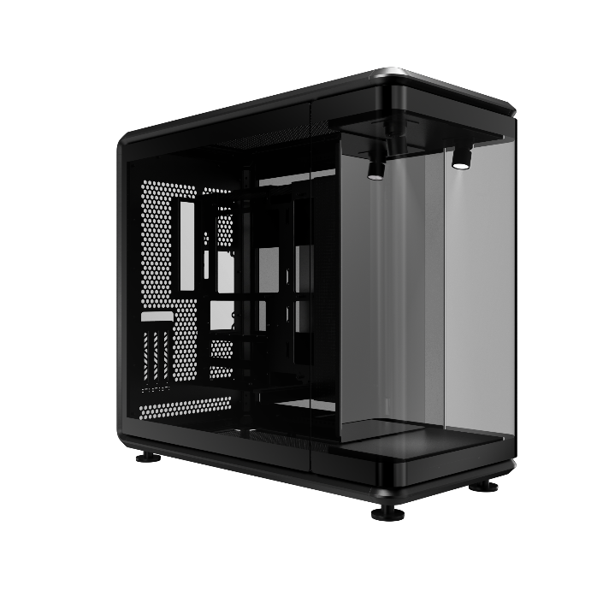
MASTERFRAME 360 PANORAMA
MASTERFRAME 360 PANORAMA
MasterFrame 360 PANORAMA is an open-frame showcase chassis designed for builders who demand both performance and presentation. Featuring panoramic tempered glass side panels, modular component support, and next-gen connectivity, it offers a striking platform to display your hardware and creativity. With built-in PCIe 5.0 riser and ARGB spotlights, it's ready to shine right out of the box.
FEATURES
Industry-First 360° DIY Liquid Cooling Chassis
Introducing the market’s first 360-degree showcase chassis—purpose-built for open-loop liquid cooling. Create a full-wrap cooling loop around your system with dedicated space and mounting options that allow tubing to flow around all sides like a custom amusement park ride.
Panoramic Glass Design for Immersive Showcase
Showcase your build—and your collectibles—from every angle with ultra-clear tempered glass panels on three sides.
Like a 360-degree display case, it reveals every detail of your components and figures with stunning clarity. Whether you're highlighting open-loop liquid cooling or custom hardware configurations, this chassis turns your rig into a show-stopping centerpiece with story and style.
Front Display Stage for Personal Style
A mirrored front platform lets you exhibit your favorite collectibles, figures, or themed accessories, blending personal expression with system aesthetics. Combined with front-facing ARGB effects, your setup becomes a vivid and playful showcase.
Massive Cooling Compatibility
To ensure exceptional thermal performance, the case supports fan sizes ranging from 120 mm to 200 mm, with space for up to twelve 120 mm fans—six on the top and six on the bottom. It also supports radiators up to 360 mm, meeting the cooling demands of high-end custom liquid cooling setups.
Compatible with Standard and BTF Motherboards
Compatible with Mini-ITX, Micro-ATX, and ATX motherboards, including BTF (back-connect) layouts within the ATX form factor.
Features 110 mm of cable routing clearance for a clean and clutter-free showcase.
PCIe 5.0 Riser Cable Included
Includes a premium PCIe 5.0 riser cable that enables vertical GPU mounting providing both next-gen performance and an elevated presentation right out of the box.
Wide Component Compatibility
Accommodates up to 430 mm GPUs and 210 mm PSUs built to handle flagship components without compromise.
Next-Gen Connectivity at Your Fingertips
Features USB 4.0 Gen 2x2 Type-C (up to 20G) and 2x USB 3.2 Gen 1 Type-A ports (up to 5G), providing ultra-fast data transfer and future-ready accessibility.

Slide 2
MASTERFRAME 360 PANORAMA
PRODUCT SPECIFICATIONS
Product Information | Product Name | MASTERFRAME 360 PANORAMA
 | Series | MASTERFRAME Series
 | Color | Black
 | Model Number | MF360-KINN-S00
Materials | Exterior | SGCC
 | Side Panel (Left / Right) | TG / TG
Dimension (L x W x H) | Incl. Protrusions | 549 x 291 x 581 mm
 | Excl. Protrusions | 511 x 291 x 581 mm
 | Volume (w/o panel, protrusions and feet) | 86 L
 | Volume (with panel, protrusions and feet) | 93 L
Hardware support | Motherboard Support | Mini-ITX, Micro-ATX, ATX, BTF (ATX)
 | Power Supply Support | ATX
 | PCI Expansion Slots | 3.5
Drive bay support | 5.25" Drive Bay | 0
 | 3.5" Drive Bay / 2.5" Drive Bay(or SSD) | HDD(44.45mm)*1 or SSD*2
Preinstalled Drive bay | 3.5" Drive Bay (remark Toolfree quantity) / 2.5" Drive Bay(or SSD)(remark Toolfree quantity) | HDD(44.45mm)*1 or SSD*2
I/O Panel | USB Ports | 2x USB 3.2 Gen 1 Type-A 5G 1x USB 4.0 Gen 2x2 Type-C 20G
 | Audio In / Out | 1x 3.5mm Headset Jack (Audio+Mic)
Fans Support | Top | 6x 120mm, 2x 140mm, 2x 180mm, 2x 200mm
 | Bottom | 6x 120mm, 2x 140mm, 2x 180mm, 2x 200mm
Radiator Support | Top | 120 / 140 / 240 / 280 / 360 mm (maximum thickness clearance 75mm)
 | Bottom | 120 / 140 / 240 / 280 / 360 mm (maximum thickness clearance 75mm)
Dust Filters | Removable Filters | Mesh Only
Other electronic components |  | 1x PCI-e 5.0 Riser Cable / 2x ARGB spotlight
Maximum Dimensions for Front Collectibles Display (H x W x D) |  | 360 x 220 x 118 mm
DIY tank & Pump support |  | Yes (with right side tank & pump bracket)
Toolbox |  | Yes
Clearances | CPU Cooler | 145 mm
 | Power Supply | 210 mm
 | Graphics Card | 430 mm
Cable Routing | Behind MB Tray | 110 mm
Warranty |  | 2 Years

Slide 3
MASTERFRAME 360 PANORAMA
SHIPPING DETAILS
Product Name |  | MASTERFRAME 360 PANORAMA（MF360-KINN-S00）
EAN Code | Global | 4719512163412
 | CN | 6928968323815
UPC Code |  | 884102135699
Net Weight |  | 14.79 KG
Gross Weight |  | 19.23 KG
Carton Dimension (L x W x H) |  | 650 x 430 x 728 mm
Container 20 feet |  | With Pallet | 90
 |  | Carton / Pallet | 9
 |  | Without Pallet | 135
Container 40 feet |  | With Pallet | 180
 |  | Carton / Pallet | 9
 |  | Without Pallet | 270
Container 40 HQ |  | With Pallet | 240
 |  | Carton / Pallet | 12
 |  | Without Pallet | 318

